Slide 1
Planning
Notes:
AI 3.2 PARTIAL ORDER PLANNING PART-II
https://www.youtube.com/watch?v=5nU2voieFb4

Slide 2
Why Planning ?
We have already discussed
Search based problem solving
Logical planning agents
Action and state
How forward and backward search algorithms can be used
Some complex planning
We need to explore the problems that are not constrained to consider only totally ordered sequence of action

Slide 3
We will consider fully observable , deterministic , finite , static and discrete environment they are called classical planning

Slide 4
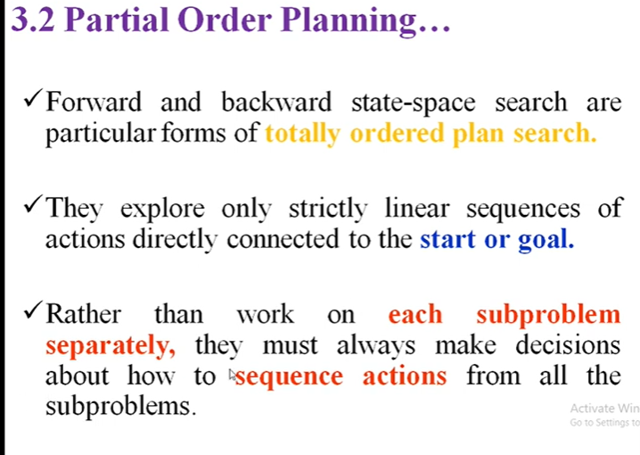

Slide 5
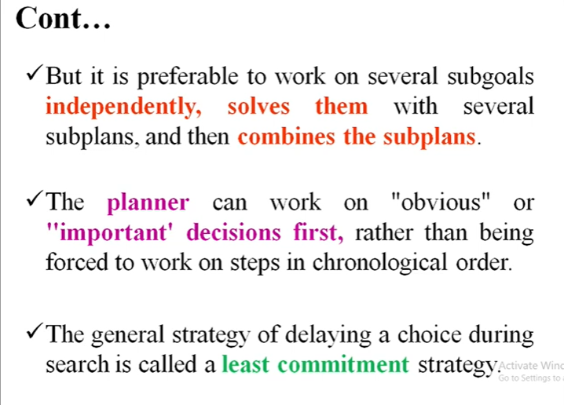

Slide 6
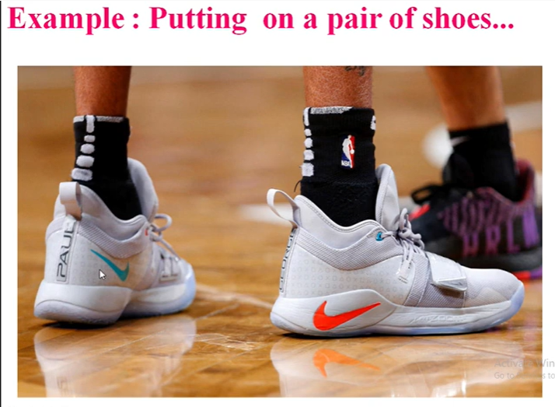

Slide 7
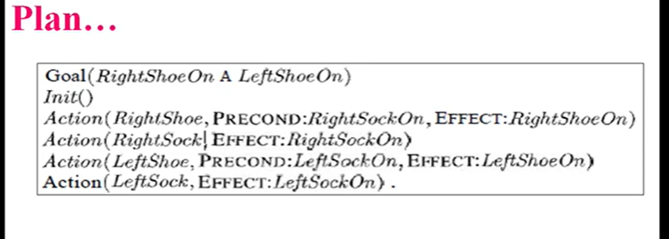

Slide 8
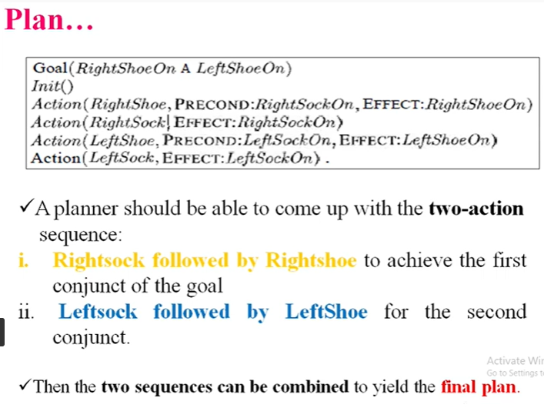

Slide 9
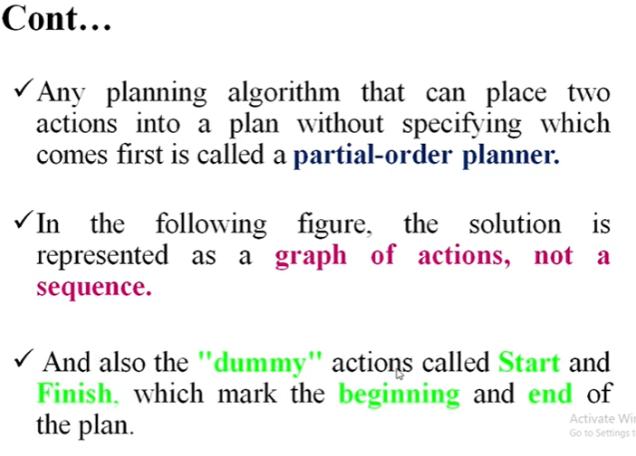

Slide 10
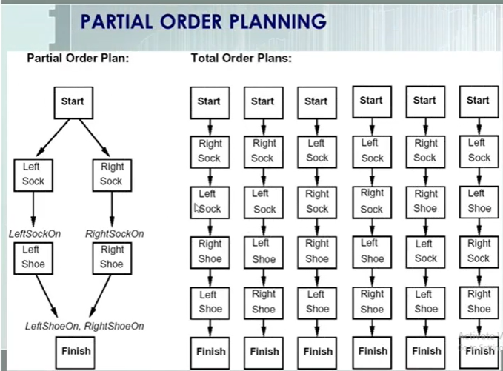
Planning graph

Slide 11
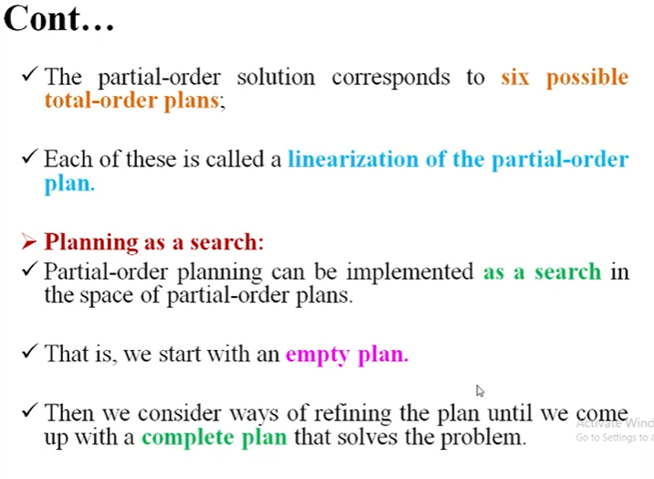

Slide 12
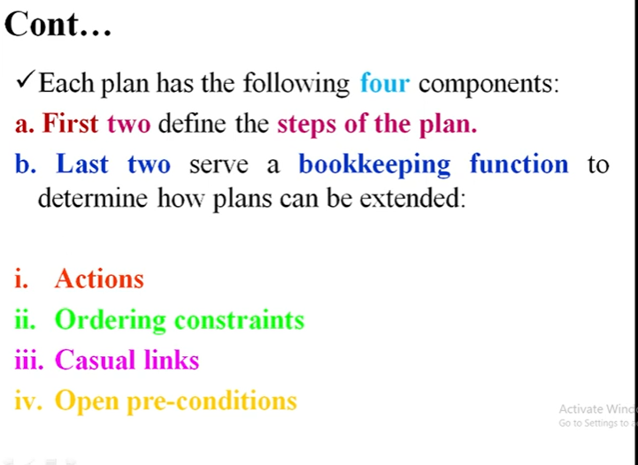

Slide 13
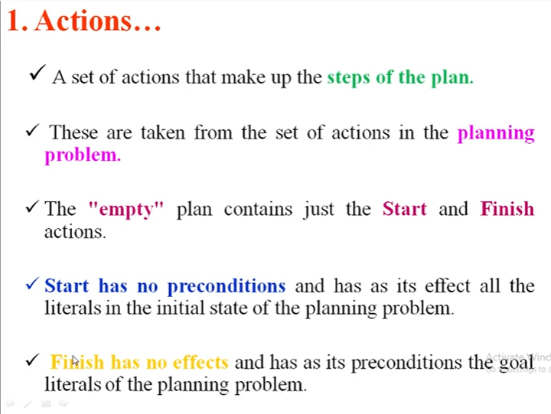

Slide 14
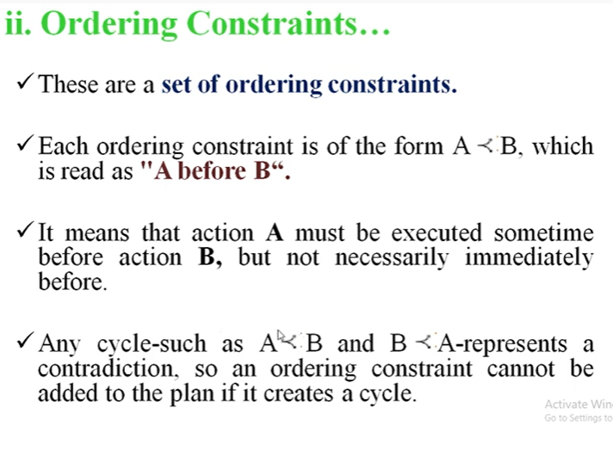

Slide 15
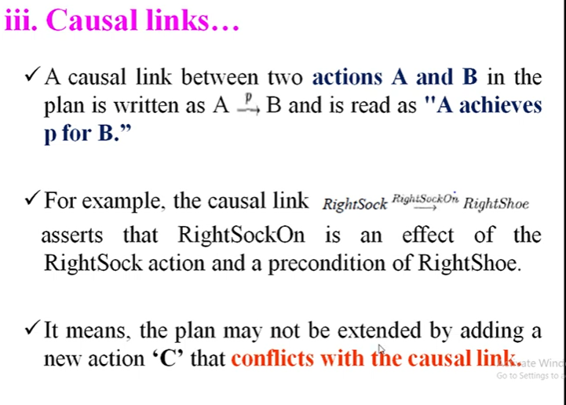

Slide 16
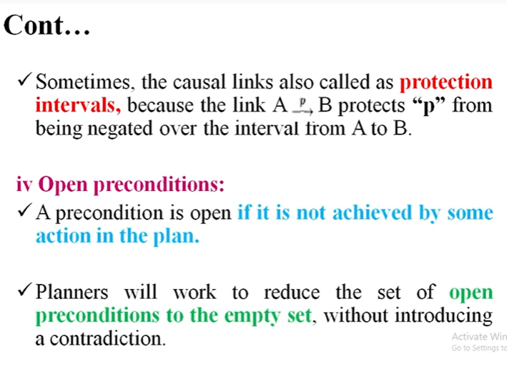

Slide 17
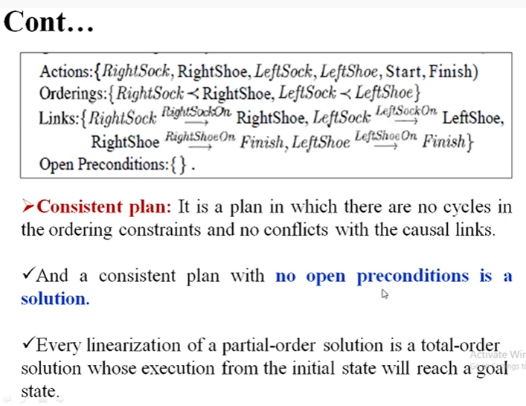

Slide 18
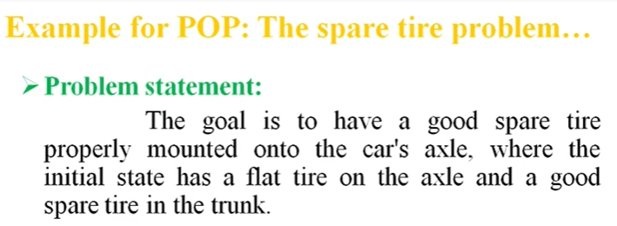

Slide 19
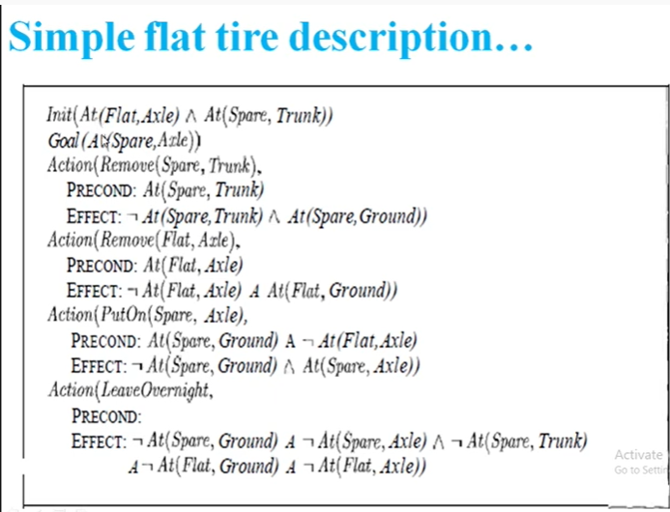
Action Description language (ADL)

Slide 20
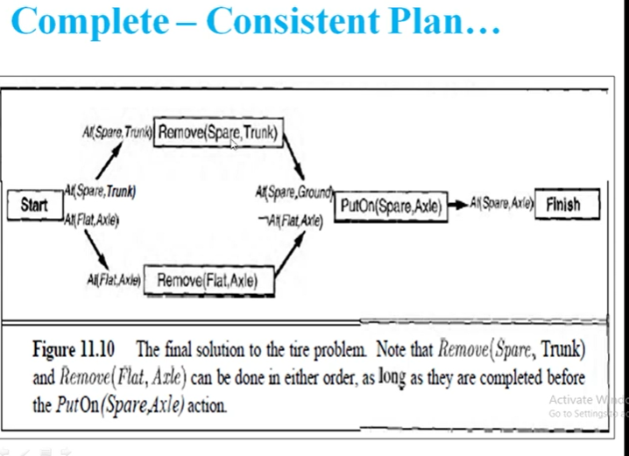
Planning Graph

